Slide 1
Chapter 14
Biomolecules
Himani Medhi
Department of Chemistry

Slide 2
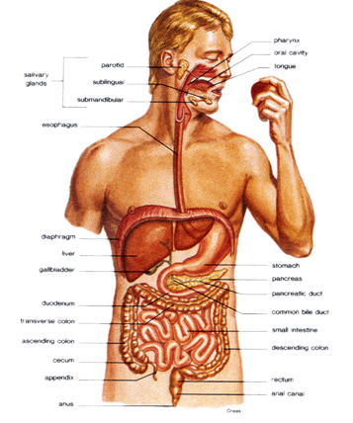
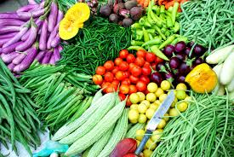
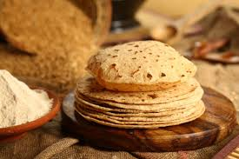
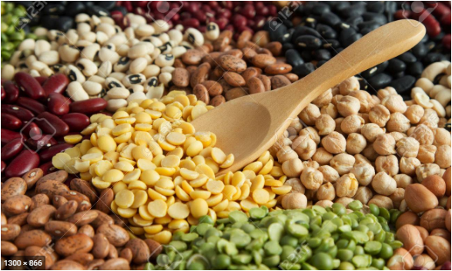
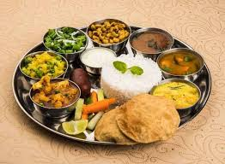
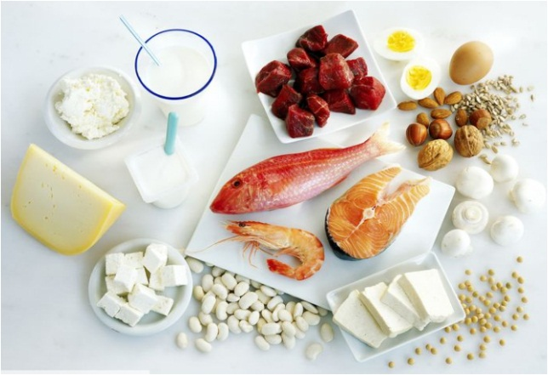
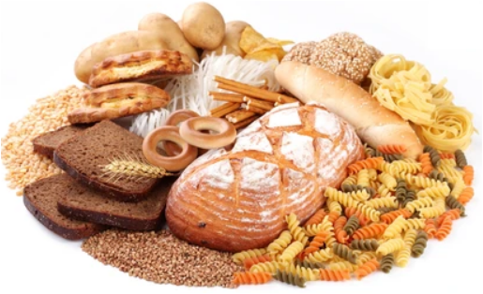
Biomolecules around us…

Slide 3
Biomolecule, also called biological molecule, that are produced by cells and living organisms.
Biomolecules have a wide range of sizes and structures and perform a vast array of functions.
The four major types of biomolecules are carbohydrates, lipids, nucleic acids, and proteins.
In addition to this four, there some molecules like vitamins and mineral salts also plays important role in the functions of organisms.

Slide 4
Carbohydrates
Carbohydrates are the most abundant organic molecules in nature.
The term carbohydrate is derived from the French term hydrate de carbon i.e., it is a hydrate of carbon or C_{n}(H₂O)_{n}.
Carbohydrates are defined as organic substances having C, H and O wherein H and O are in the ratio 2:1 as found in H₂O.
Chemically, the carbohydrates may be defined as optically active polyhydroxy aldehydes or ketones or the compounds which produce such units on hydrolysis.

Slide 5
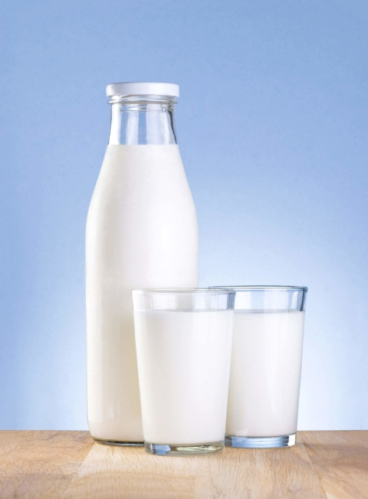
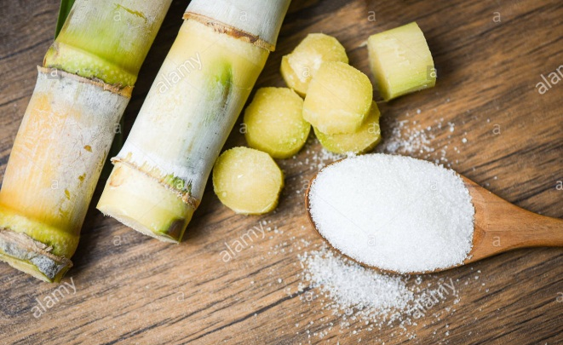
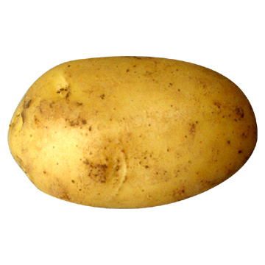
The most common sugar, used in our homes is named as sucrose
whereas the sugar present in milk is known as lactose.
Carbohydrates are also called saccharides (Greek: sakcharon means sugar).
Lactose
Sucrose
Starch
Milk
Cane sugar
Potato

Slide 6
For example,
the molecular formula of glucose (C₆H₁₂O₆) fits into this general formula, C₆ (H₂O)₆
Exceptions
Acetic acid (CH₃COOH) fits into this general formula, C₂(H₂O)₂ but is not a carbohydrate.
Rhamnose, C₆H₁₂O₅ is a carbohydrate but does not fit to the general formula of carbohydrates.

Slide 7
Classification of carbohydrate
Carbohydrates are classified into three groups on the basis of their behaviour on hydrolysis.
Carbohydrate
No further hydrolysis
Many monosaccharides on hydrolysis
Monosaccharides
Polysaccharides
2-10 monosaccharides
on hydrolysis
Oligosaccharides

Slide 8
Carbohydrates are classified into two groups on the basis of whether they can reduce Fehling's solution and Tollens’ reagent or not.
Carbohydrates
That can reduce Fehling's solution and Tollens’ reagent
That can not reduce Fehling's solution and Tollens’ reagent
Rducing carbohydrates
Non-reducing carbohydrates

Slide 9
Monosaccharides
A carbohydrate that cannot be hydrolysed further to give simpler unit of polyhydroxy aldehyde or ketone is called a monosaccharide.
About 20 monosaccharides are known to occur in nature.
Some common examples are glucose, fructose, ribose, etc.

Slide 10
Monosaccharides are further classified on the basis of the functional group present in them.
Monosaccharide
Having aldehyde (-CHO) functional group
Having ketone (>C=O) functional group
Aldose
Ketose

Slide 11
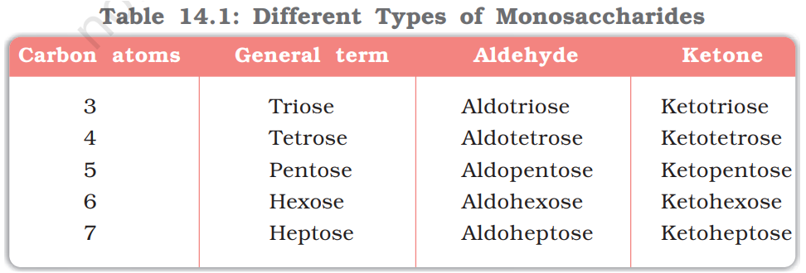
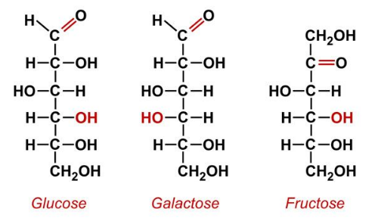
Monosaccharides are further classified on the basis of number of carbon atoms in the molecule.
(C₆H₁₂O₆)
(C₆H₁₂O₆)
(C₆H₁₂O₆)

Slide 12
Oligosaccharides
Carbohydrates that yield two to ten monosaccharide units on hydrolysis, are called oligosaccharides.
They are further classified as
disaccharides,
trisaccharides,
tetrasaccharides, etc., depending upon the number of monosaccharides, they produce on hydrolysis.

Slide 13
Disaccharides produce two monosaccharide units on hydrolysis and these monosaccharide units of a disaccharide may be of same or different types.
For example,
Sucrose
Glucose
Fructose
Maltose
Glucose
Glucose
Lactose
Glucose
Galactose

Slide 14

Polysaccharides
Carbohydrates which yield a large number of monosaccharide units on hydrolysis are called polysaccharides.
Some common examples are starch, cellulose, glycogen, gums, etc.
Polysaccharides are not sweet in taste, hence they are also called non-sugars.

Slide 15
Functions/Importance of Carbohydrates
Carbohydrates are essential for life in both plants and animals. They form a major portion of our food.
It is the most abundant source of energy (4 cal/g) and it provides quick energy to the body.
Carbohydrates are used as storage molecules as starch and cellulose in plants and glycogen in animals.
We build furniture etc. from cellulose in the form of wood and clothe from cellulose in the form of cotton fiber.
Carbohydrates provide raw materials for many important industries like textiles, paper, lacquers and breweries.

Slide 16
Home work
What are carbohydrates? How they have been classified? What are the importance of carbohydrates?
What are monosaccharides? How they have been classified?
Name the monosaccharides obtained on hydrolysis of the following disaccharides:
Sucrose, lactose and maltose
4. Why polysaccharides are called as non-sugars?
5. What do you mean by reducing and non-reducing sugars?

Slide 17
Some important Carbohydrates
Their structure
Their preparation methods
08/07/2021

Slide 18
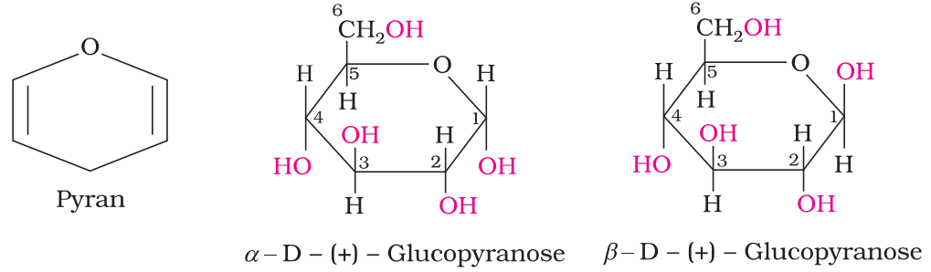

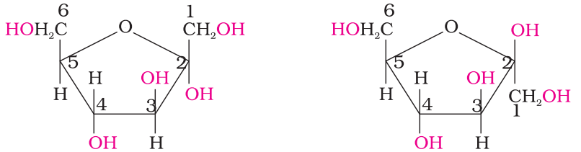
Glucose (C₆H₁₂O₆) (aldohexose)
Fructose (C₆H₁₂O₆) (ketohexose)
It is present in sweet fruits and honey.
Ripe grapes also contain glucose in large amounts.
It is a natural monosaccharide found in fruits, honey and vegetables.
In its pure form it is used as a sweetener.
Open chain
structure
Cyclic structure are represented by
Haworth structure
α-Glucose
β-Glucose
α-Fructose
β-Fructose

Slide 19
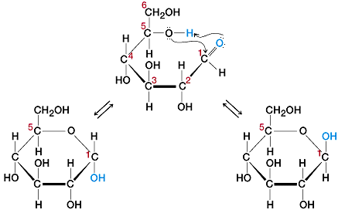
Anomeric Carbon
α-Glucose
β-Glucose
It was found that glucose forms a six-membered ring in which —OH at C-5 is involved in ring formation. Glucose exists in Two Cyclic structural forms –α and β forms.
α and β forms of glucose differ only in the configuration of the hydroxyl group at C1, called anomeric carbon (the aldehyde carbon before cyclisation) and thus these two forms are called anomers or anomeric isomers.

Slide 20
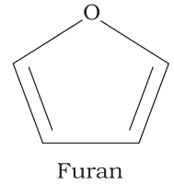
Pyran
α-Glucopyranose
β-Glucopyranose
Pyran is a cyclic organic compound with one oxygen atom and five carbon atoms in the ring and the six membered cyclic structure of glucose is called pyranose structure.
Furan
α-Fructofuranose
β-Fructofuranose
Furan is a cyclic organic compound with one oxygen atom and four carbon atoms in the ring and its analogy structures are called furanose.

Slide 21

Preparation of Glucose
From Sucrose (Cane sugar): Sucrose on heating with dilute HCl or H₂SO₄ in alcoholic solution produces glucose and fructose in equal amounts.
From Starch: Commercially glucose is obtained by hydrolysis of starch by boiling it with dilute H₂SO₄ at 393 K under 2-3 atm pressure.
Sucrose
Glucose
Fructose
Note: this is also a preparation method of fructose.
Starch
Glucose
15/07/21

Slide 22
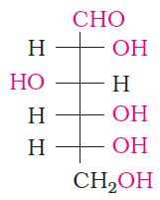
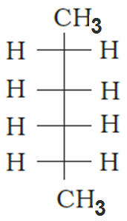

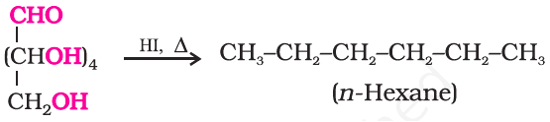
Reactions of Glucose
Reaction with hydrogen iodide:
Glucose
n-Haxane
Simply can be written as-----

Slide 23
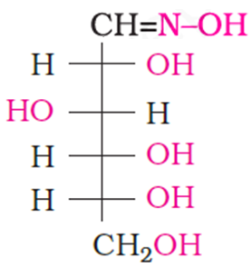

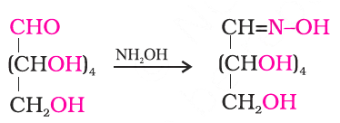
Reaction with hydroxylamine (NH₂OH):
Glucose
Oxime
Simply can be written as-----

Slide 24
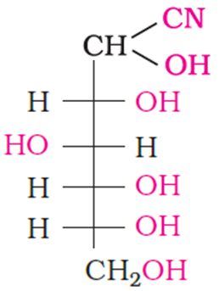

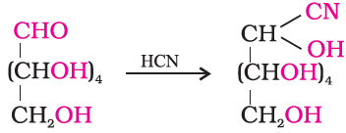
Reaction with hydrogen cyanide (HCN):
Glucose
Cyanohydrin
Simply can be written as-----

Slide 25
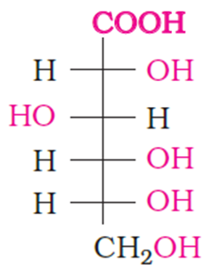

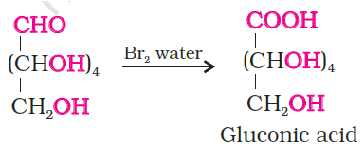
Reaction with Bromine water:
Glucose
Gluconic acid
Simply can be written as-----

Slide 26
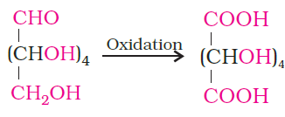

Reaction with Nitric acid:
Glucose
Saccharic acid

Slide 27
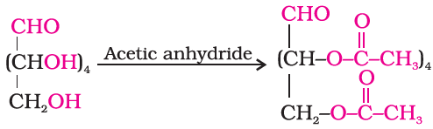
Reaction with Acetic anhydride:
Glucose
Glucose pentaacetate

Slide 28
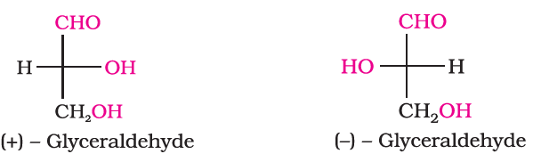
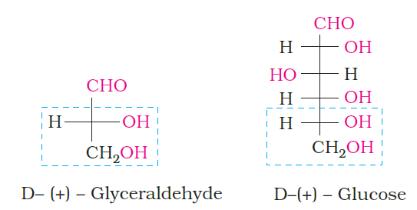
D,L –Nomenclature of carbohydrate
(+) Isomer of glyceraldehyde has ‘D’ configuration.
(-) Isomer of glyceraldehyde has ‘L’ configuration.
If the lower portion of the carbohydrate structure (marked within blue lines) have similarities with the D-glyceraldehyde then the carbohydrate is named as D-carbohydrate. e.g. ----- D-Glucose
15/07/21

Slide 29
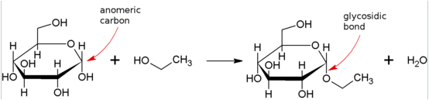
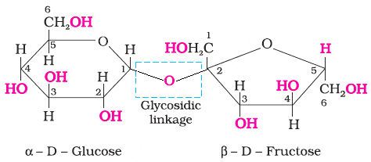
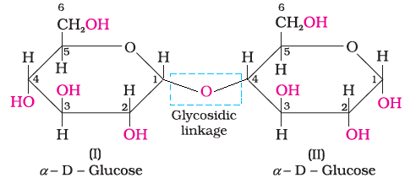
Glycosidic bond or Glycosidic linkage
A glycosidic bond or glycosidic linkage is formed between the hemiacetal or hemiketal group of a saccharide (sugar) and the hydroxyl group of some compound such as an alcohol, saccharide (sugar). For example-
Other examples:---- oligosaccharides and polysaccharides are formed by combination of a number of monosaccharides through glycosidic linkage.
Glycosidic linkage in Sucrose
Glycosidic linkage in Maltose

Slide 30
Disaccharides
Disaccharides on hydrolysis with dilute acids or enzymes yield two molecules of either the same or different monosaccharides.
Sucrose:
Sucrose
Glucose
Fructose
22/07/21

Slide 31
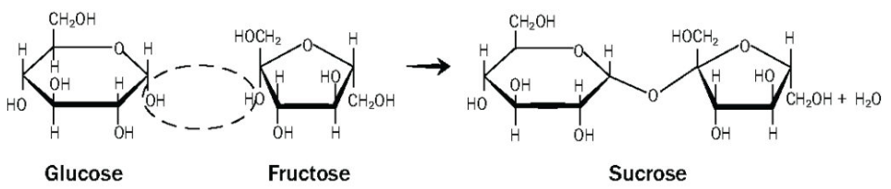
the glycosidic linkage formed between C1 of α-D-glucose and C2 of β-D-fructose. Since the reducing groups of glucose and fructose are involved in glycosidic bond formation, sucrose is a non reducing sugar.
α-Glucose
β-Fructose
Glycosidic linkage

Slide 32
Sucrose is dextrorotatory (+) but after hydrolysis gives dextrorotatory glucose and laevorotatory fructose. Since the laevorotation of fructose (–92.4°) is more than dextrorotation of glucose (+ 52.5°), the mixture is laevorotatory. Thus, hydrolysis of sucrose brings about a change in the sign of rotation, from dextro (+) to laevo (–) and the product is named as invert sugar.

Slide 33
Maltose:
Maltose is composed of two α-D-glucose units in which C1 of one glucose (I) is linked to C4 of another glucose unit (II). The free aldehyde group can be produced at C1 of second glucose in solution and it shows reducing properties so it is a reducing sugar.
Maltose

Slide 34
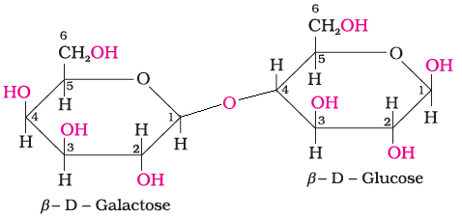
Lactose (Milk-sugar):
It is composed of β-D-galactose and β-D-glucose. The linkage is between C1 of galactose and C4 of glucose. Free aldehyde group may be produced at C-1 of glucose unit, hence it is also a reducing sugar.
Lactose

Slide 35
Polysaccharides
Polysaccharides contain a large number of monosaccharide units joined together by glycosidic linkages. They mainly act as the food storage or structural materials.
Some common polysaccharides are-
Starch, cellulose, glycogen etc.

Slide 36
Starch
Starch is the main storage polysaccharide of plants.
It is the most important dietary source for human beings.
High content of starch is found in cereals, roots, tubers and some vegetables.
It is a polymer of α-glucose and consists of two components—
Amylose and Amylopectin.

Slide 37
Amylose
Amylopectin
Amylose is water soluble component which constitutes about 15-20% of starch.
It is a long unbranched chain
It contains 200-1000, α-D-(+)-glucose units held together by C1– C4 glycosidic linkage.
Amylopectin is insoluble in water and constitutes about 80-85% of starch.
It is a branched chain polymer.
It contains α -D-glucose units in which chain is formed by C1–C4 glycosidic linkage whereas branching occurs by C1–C6 glycosidic linkage.

Slide 38
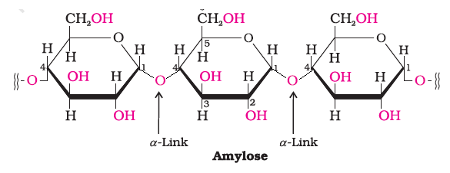
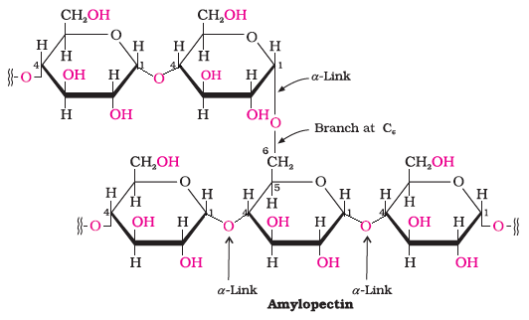

Slide 39
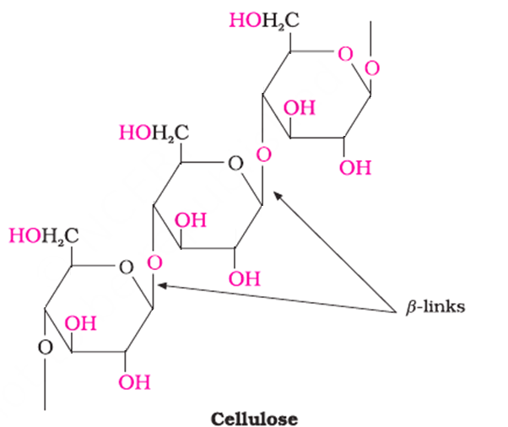
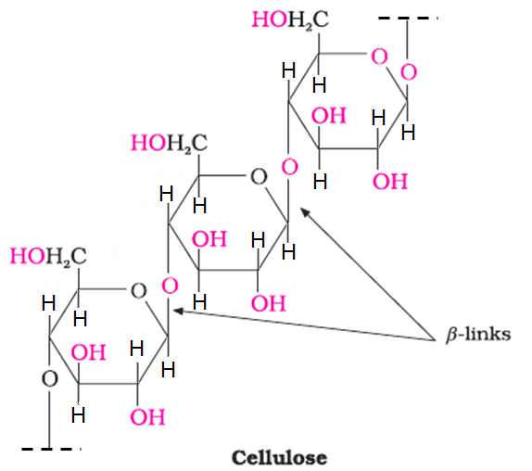
Cellulose
Cellulose occurs exclusively in plants and it is the most abundant organic substance in plant kingdom. It is a predominant constituent of cell wall of plant cells. Cellulose is a straight chain polysaccharide composed only of β-D-glucose units which are joined by glycosidic linkage between C1 of one glucose unit and C4 of the next glucose unit.
OR

Slide 40
Glycogen
The carbohydrates are stored in animal body as glycogen.
It is also known as animal starch because its structure is similar to amylopectin and is rather more highly branched.
It is present in liver, muscles and brain. When the body needs glucose, enzymes break the glycogen down to glucose. Glycogen is also found in yeast and fungi.

Slide 41
Home assignmnet
(Submit the assignmnet by Sunday)
What are differences between glucose and fructose? 2 marks
Draw the open chain structure and Haworth structure of glucose and fructose. 2 marks
What do you mean be anomers. Draw the structures of anomers of glucose. 2 marks
What do you mean be glycosidic linkage? Draw the structure of sucrose showing the glycosidic linkage present in it. 2 marks
Explain the structure of starch. Draw the structure of amylose. 2 marks
Why sucrose is also known as invert sugar? Identify the reducing sugars among the following –
Glucose, fructose, sucrose, maltose, lactose 2 marks
What is glycogen? What is its role in humane body? 2 marks
Draw the structure of cellulose. 1 mark

Slide 42
1. What are differences between glucose and fructose? 2 marks
Answer: Differences between glucose and fructose are:
Glucose | Fructose
It contains an aldehyde functional group in its open chain structure | 1. It contains a ketone functional group in its open chain structure
2. It contains pyran like ring in its cyclic structure | 2. . It contains furan like ring in its cyclic structure
α-Glucose
α-Fructose

Slide 43
2. Draw the open chain structure and Haworth structure of glucose and fructose. 2 marks
Answer: Open chain structures:
Haworth structures:
α-Glucose
β-Glucose
α-Fructose
β-Fructose

Slide 44
3. What do you mean be anomers? Draw the structures of anomers of glucose. 2 marks
Answer: Anomers are isomers that differ from each other in the configuration of C-1 if they are aldoses or in the configuration at C-2 if they are ketoses.
α-Glucose
β-Glucose
Glucose exist in two anomeric form
α-Glucose and β-Glucose
These two isomers are differ only in position of OH group at C-1 carbon (marked by a red colored curve)

Slide 45
4. What do you mean be glycosidic linkage? Draw the structure of sucrose showing the glycosidic linkage present in it. 2 marks
Answer: A glycosidic bond or glycosidic linkage is formed between the hemiacetal or hemiketal group of a saccharide (sugar) and the hydroxyl group of some compound such as an alcohol, saccharide (sugar).
The structure of sucrose is-
Sucrose

Slide 46
5. Explain the structure of starch. Draw the structure of amylose. 2 marks
Answer: Starch is a polymer of α-glucose. It consists of two components— Amylose and Amylopectin.
Amylose is long unbranched chain polymer. It contains 200-1000, α-D-(+)-glucose units held together by C1– C4 glycosidic linkage.
While, amylopectin is branched chain polymer. It contains α -D-glucose units in which chain is formed by C1–C4 glycosidic linkage whereas branching occurs by C1–C6 glycosidic linkage.

Slide 47
6. Why sucrose is also known as invert sugar? Identify the reducing sugars among the following–
Glucose, fructose, sucrose, maltose, lactose 2 marks
Answer of first Part: Sucrose is dextrorotatory (+ 66.37°) but after hydrolysis gives dextrorotatory glucose and laevorotatory fructose. Since the laevorotation of fructose (–92.4°) is more than dextrorotation of glucose (+ 52.5°), the mixture is laevorotatory. Thus, hydrolysis of sucrose brings about a change in the sign of rotation, from dextro (+) to laevo (–) and the product is named as invert sugar.
Sucrose
Glucose
Fructose
(+ 66.37°)
Dextrorotatory
(+ 52.5°)
Dextrorotatory
(–92.4°)
Leavorotatory
(+ 52.5°) + (–92.4°) = (–39.9°)
Answer of second Part: The reducing sugars are:
Glucose, fructose, maltose, lactose

Slide 48
7. What is glycogen? What is its role in humane body? 2 marks
Answer of first part:
Glycogen is a carbohydrate that is found to be stored in animal body as stored energy supplement. It is also known as animal starch because its structure is similar to amylopectin and is rather more highly branched.
Answer of second part:
Glycogen is stored in liver, muscles and brain. When the body needs glucose, enzymes break the glycogen down to glucose.

Slide 49
8. Draw the structure of cellulose. 1 mark
Answer:

Slide 50
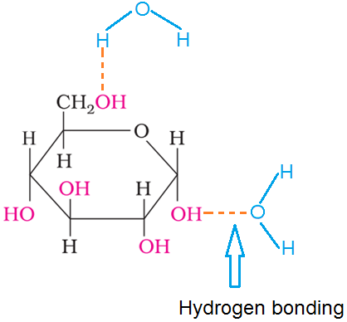
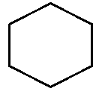
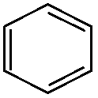
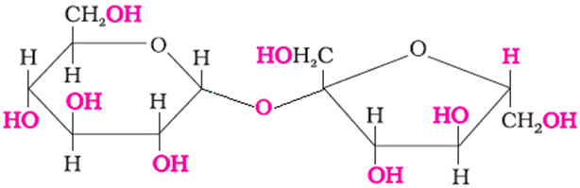
NCERT in text questions
14.1 Glucose or sucrose are soluble in water but cyclohexane or benzene (simple six membered ring compounds) are insoluble in water. Explain.
Answer: A glucose molecule contains five −OH groups while a sucrose molecule contains eight −OH groups. Thus, glucose and sucrose undergo extensive H-bonding with water and hence they are soluble in water.
But cyclohexane and benzene do not contain −OH groups. Hence, they cannot undergo H-bonding with water and as a result, are insoluble in water.
There is no possibility of formation of hydrogen bonding
Cyclohexane
Benzene
Glucose molecule forming a few hydrogen bonding with water molecules
Sucrose

Slide 51
14.2 What are the expected products of hydrolysis of lactose?
Answer: The products of hydrolysis of lactose are Glucose and Galactose.
Lactose
Glucose
Galactose

Slide 52
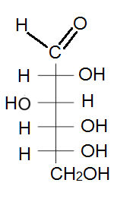
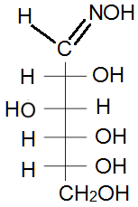
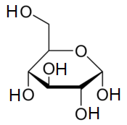



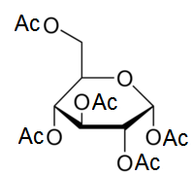

14.3 How do you explain the absence of aldehyde group in the pentaacetate of D-glucose?
Answer: Glucose reacts with hydroxylamine to form an oxime where as the penta acetate of glucose does not react with hydroxyl amine indicating the absence of free CHO group.
Note: Ac = CH₃CO

Slide 53
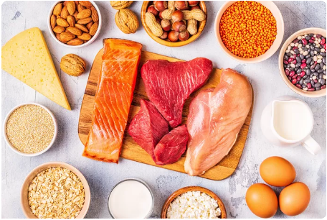
Proteins
Proteins are the most abundant biomolecules of the living system. Chief sources of proteins are milk, cheese, pulses, peanuts, fish, meat etc.
They occur in every part of the body and form the fundamental basis of structure and functions of life. They are also required for growth and maintenance of body.
The word protein is derived from Greek word, “proteios” which means primary or of prime importance.
All proteins are polymers of α-amino acids.
5/8/21

Slide 54

Amino Acids
Amino acids contain amino (–NH₂) and carboxyl (–COOH) functional groups.
Depending upon the relative position of amino group with respect to carboxyl group, the amino acids can be classified as α, β, γ, δ and so on. Only α-amino acids are obtained on hydrolysis of proteins.
They may contain other functional groups also.
α
General formula of α -amino acid
(where, R = side chain)

Slide 55
All α-amino acids have trivial names, which usually reflect the property of that compound or its source. For example-
Glycine is so named since it has sweet taste (in Greek glykos means sweet) and tyrosine was first obtained from cheese (in Greek, tyros means cheese.)
Amino acids are generally represented by a three letter symbol, sometimes one letter symbol is also used.

Slide 56
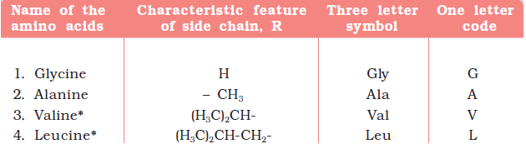
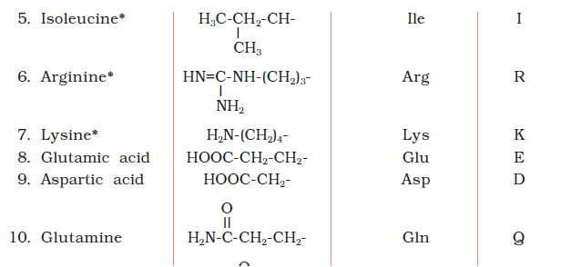
Natural Amino acids

Slide 57
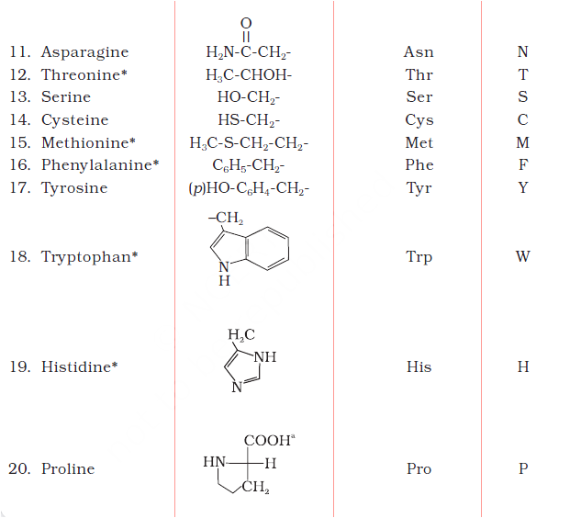


Slide 58
Classification of amino acids
Amino acids
Non-Essential
amino acids
Essential
amino acids
The amino acids, which can be synthesised in the body, are known as non-essential amino acids.
The amino acids, which cannot be synthesised in the body and must be obtained through diet, are known as essential amino acids.

Slide 59


Acidic nature of carboxyl group:
Basic nature of amino group:

Slide 60




Classification of amino acids
(depending on the relative number of amino and carboxyl group in their molecule)
Amino acids
More carboxyl groups as compared to amino groups
More number of amino than carboxyl groups
Equal number of amino and carboxyl groups
Acidic
amino acids
e.g. Aspartic acid
Neutral
amino acids
e.g. Glycine
Basic
amino acids
e.g. Lysine

Slide 61

Physical and Chemical Nature of Amino Acids
Amino acids are usually colourless, crystalline solids.
These are water-soluble, high melting solids and behave like salts rather than simple amines or carboxylic acids. This behaviour is due to the presence of both acidic (carboxyl group) and basic (amino group) groups in the same molecule. In aqueous solution, the carboxyl group can lose a proton and amino group can accept a proton, giving rise to a dipolar ion known as zwitter ion.
Zwitter ion is a neutral ionic species which contains both positive and negative charges. (Definition)
H₂O
Zwitter ion

Slide 62



In zwitter ionic form, amino acids show amphoteric behaviour as they react with both acids and bases.
H⁺/H₂O
Zwitter ion
HO⁻/H₂O
Except glycine, all other naturally occurring α-amino acids are optically active, since the α-carbon atom is asymmetric.
α
General formula of α-amino acids

Slide 63


These exist both in ‘D’ and ‘L’ forms. Most naturally occurring amino acids have L-configuration.
L-Amino acids are represented by writing the –NH₂ group on left hand side.

Slide 64
Home assignmnet
(Submit the assignmnet by Sunday-8/8/21)
Q.1. What are essential and non-essential amino acids? Give two examples of each type. 4 marks
Q.2. How do you explain the amphoteric behaviour of amino acids? 3 marks
Q.3. Fill up the blank:
a) Proteins are polymers of __________. 1 mark
b) All amino acids are optically active (contain a chiral alpha carbon) except __________. 1 mark
c) Most naturally occurring amino acids have __________ configuration. 1 mark

Slide 65

Structure of Protein Molecules
All proteins are polymers of α-amino acids.
α-amino acids are connected to each other by peptide bond or peptide linkage (–CO–NH–). Chemically, peptide linkage is an amide bond formed between –COOH group and –NH₂ group.
Gly
Ala
Dipeptide

Slide 66
Combination of amino acids through peptide (-CO-NH-) bonds leads to the formation of -
Dipeptide
Tripeptide
Tetrapeptide
Polypeptide
is made up of two
amino acids and contains one peptide/amide (–CO-NH-) bond
is made up of Three
amino acids and contains Two peptide/amide (–CO-NH-) bonds
is made up of Four
amino acids and contains Three peptide/amide (–CO-NH-) bonds
is made up of
more than 10 number of
amino acids
A polypeptide with more than hundred
amino acid residues, having
molecular mass
higher than 10,000u
is called
a protein.
e.g., Gly-Ala
e.g., Gly-Ala-Val
e.g., Gly-Ala-Val-Leu
Note: Polypeptides with fewer amino acids are likely to be called
proteins if they ordinarily have a well defined conformation of a protein such as insulin which contains 51 amino acids.

Slide 67
Classification of Protein
On the basis of molecular shape
Fibrous proteins
Globular proteins
When the polypeptide chains run parallel and are held together by hydrogen and disulphide bonds, then fibre– like structure is formed.
These proteins are generally insoluble in water.
Some common examples are
keratin (present in hair, wool, silk) and myosin (present in muscles) etc.
This structure results when the chains of polypeptides coil around to give a spherical shape.
These are usually soluble in water.
Some common examples are
Insulin and albumins

Slide 68
Structure and shape of proteins
can be studied at four different levels
Primary or 1°
It is the simplest protein structure and shape
Secondary or 2°
Tertiary or 3°
It is a folded 1° structure of protein and shape is a little complex than 1°.
It is of two types-
alpha helix,
beta-pleated sheet
It is further folding of 2° structure of protein and shape is more complex than 2°.
It gives rise to two major molecular shapes
viz. fibrous and globular.
Quaternary or 4°
It is composed of two or more 3° polypeptide
chains referred to as sub-units. The 4° shape is more complex than 3° one.

Slide 69

In the primary structure of protein, amino acids are connected through peptide (amide, -CO-NH-) bonds.

Slide 70
β

Slide 71

Tertiary structure
The main forces which stabilise the 2° and 3° structures of proteins are hydrogen bonds, disulphide linkages, van der Waals and electrostatic forces of attraction.

Slide 72


Secondary

Slide 73
Denaturation of Proteins
Protein found in a biological system with a unique three-dimensional structure and biological activity is called a native protein.
When a protein in its native form, is subjected to physical change like change in temperature or chemical change like change in pH, the hydrogen bonds are disturbed. Due to this, globules unfold and helix get uncoiled and protein loses its biological activity. This is called denaturation of protein. During denaturation secondary and tertiary structures are destroyed but primary structure remains intact. For example-
The coagulation of egg white on boiling is a common example of denaturation.
Curdling of milk is caused due to the formation of lactic acid by the bacteria present in milk.

Slide 74

Home assignmnet
(Submit the assignmnet by Sunday-15/8/21)
Q1. Define the following as related to proteins -
(i) Peptide linkage (ii) Primary structure $1\frac{1}{2}+1\frac{1}{2}$ =3 marks
Q2. Differentiate between globular and fibrous proteins. 2 marks
Q3. What type of bonding helps in stabilising the α-helix structure of proteins? 1 mark
Q4. What are the common types of secondary structure of proteins? 1 mark
Q5. What do you mean by denaturation of Protein? Give an example. 2 marks
Q6. What is the effect of denaturation on the structure of proteins? 1 mark

Slide 75

Enzymes
An enzyme is a biological catalyst and is almost always a protein.
It speeds up the rate of a specific chemical reaction in the cell.
The enzyme is not destroyed during the reaction and is used over and over.
A cell contains thousands of different types of enzyme molecules, each specific to a particular chemical reaction.
They are generally named after the compound or class of compounds upon which they work. For example, the enzyme that catalyses hydrolysis of maltose into glucose is named as maltase.

