Slide 1
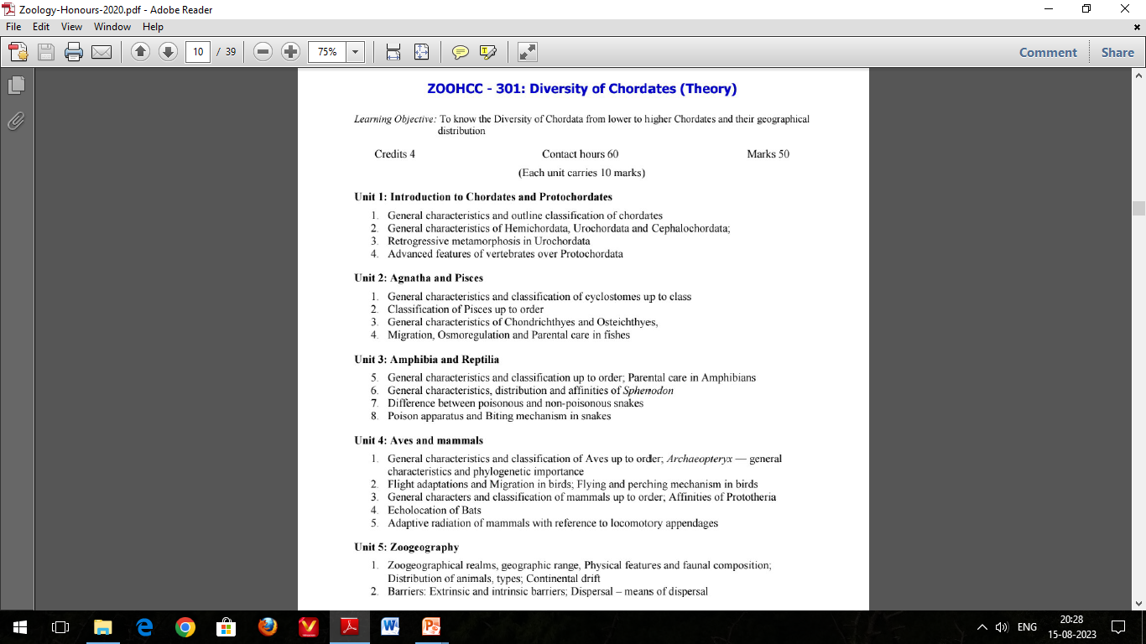

Slide 2
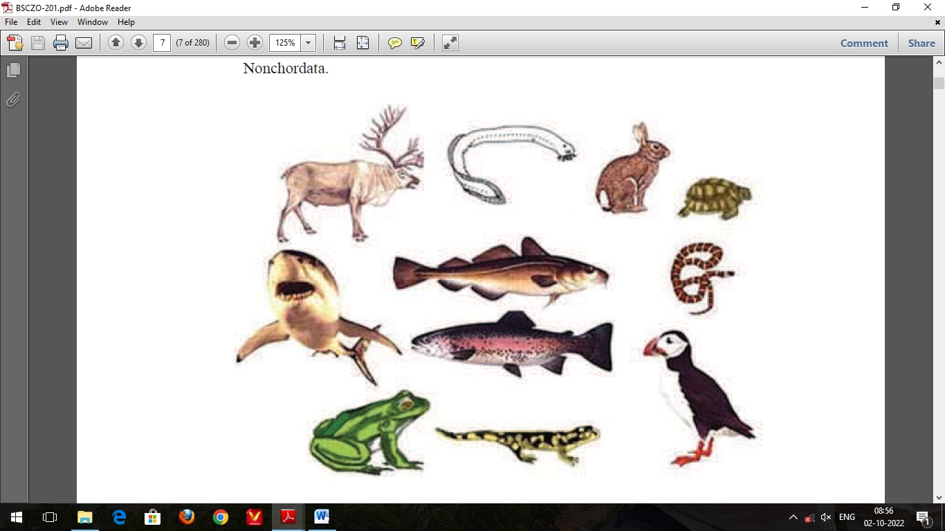
GENERAL CHARACTERISTICS AND OUTLINE CLASSIFICATION OF CHORDATES

Slide 3
Animal kingdom is basically divided into two sub kingdoms:
Non-chordata: Includes animals without notochord.
Chordata: This comprising animals having notochord or chorda dorsalis. While the Chordata has a notochord at some stage during the life, it is not known to exist in the Non-chordata.
All chordates have the following features at some stage in their life:
Pharyngeal slits
Dorsal tubular nerve cord
Notochord
Post-anal tail

Slide 4
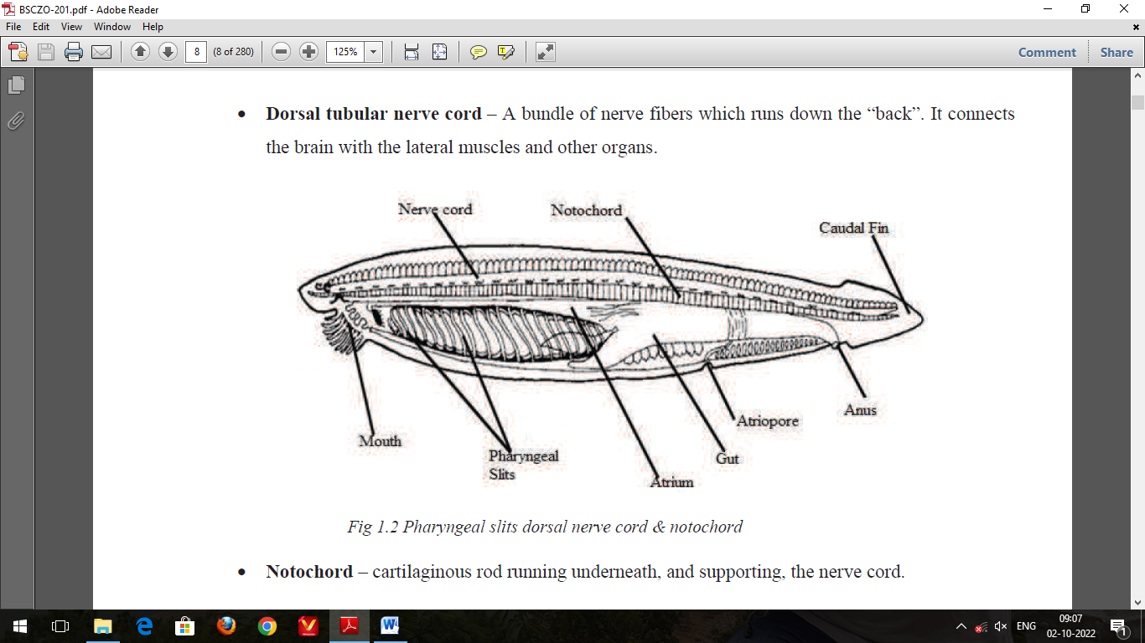
Pharyngeal slits: a series of openings that connect the inside of the throat to the outside of the “neck”. These are often, but not always, used as gills.
Dorsal tubular nerve cord: A bundle of nerve fibres which runs down the “back”. It connects the brain with the lateral muscles and other organs.
Notochord: cartilaginous rod running underneath, and supporting, the nerve cord.
Post-anal tail: Extensions of the body post the anal opening.

Slide 5
GENERAL CHARACTERSTICS OF CHORDATES:
Aquatic, aerial or terrestrial all free living with no fully parasitic forms.
Bilaterally symmetrical and metamerically segmented.
Exoskeleton often present well developed in most vertebrates.
Body wall triploblastic with 3 germinal layers: ectoderm, mesoderm and endoderm.
Coelomate animals with a true coelom, enterocoelic or schizocoelic in origin.
A skeletal rod, the notochord, present at some stage in life cycle.
Digestive system complete with digestive glands.
Blood vascular system closed. Heart ventral with dorsal and ventral blood vessels.
Hepatic portal system well developed.
Excretory system comprising proto- or meso- or meta-nephric kidneys.

Slide 6
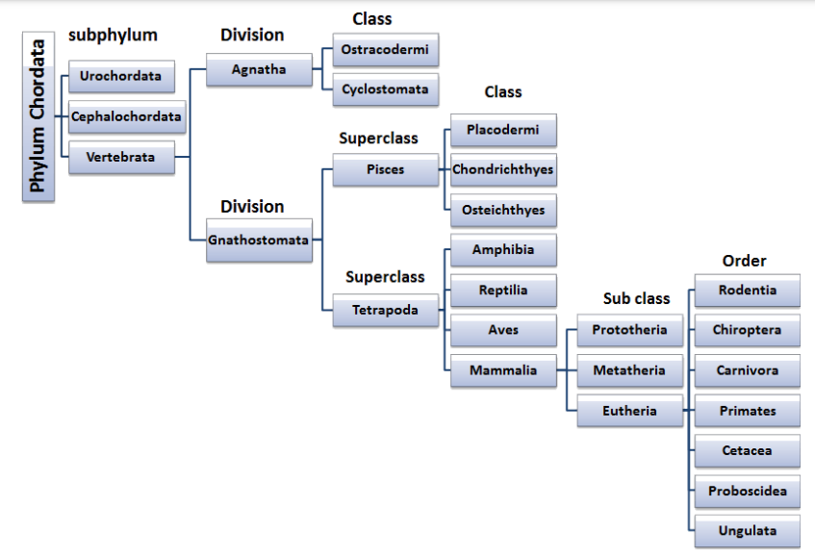
CLASSIFICATION OF CHORDATES

Slide 7
Phylum Chordata has three subphyla: Urochordata, Cephalochordata and Vertebrata.
Sub-phylum Urochordata:
Marine, mostly sessile, filter-feeders.
Notochord occurs only in the tail of the larva and disappears in the adult.
The tail does not persist throughout life, Example: Herdmania, Doliolum, and Ciona.
2. Sub-phylum Cephalochordata:
Notochord extends to the tip of the snout and persists throughout life.
Tail persists throughout life, Example: Amphioxus.
3. Sub-phylum Vertebrate:
Notochord replaced by vertebral column (back bone).
Dorsal tubular nerve cord present which is divided into brain and spinal cord.

Slide 8
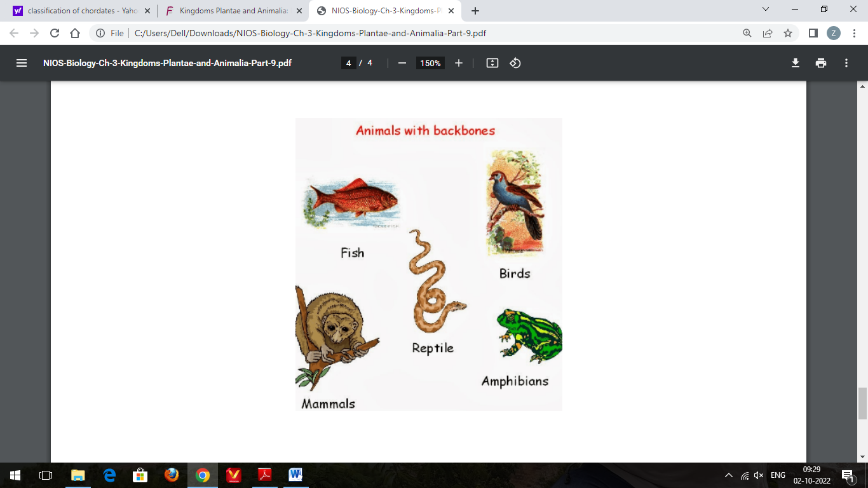
The chordates are of various body forms but they all have notochord, dorsal tubular nerve cord, pharyngeal slits and a post anal tail at some stage of life.Various theories have been proposed to explain the origin and evolution of chordates but none of them is completely satisfactory. However, it is believed that they evolve sometimes before Cambrians. The most advanced forms of chordates are mammals.

