Slide 1
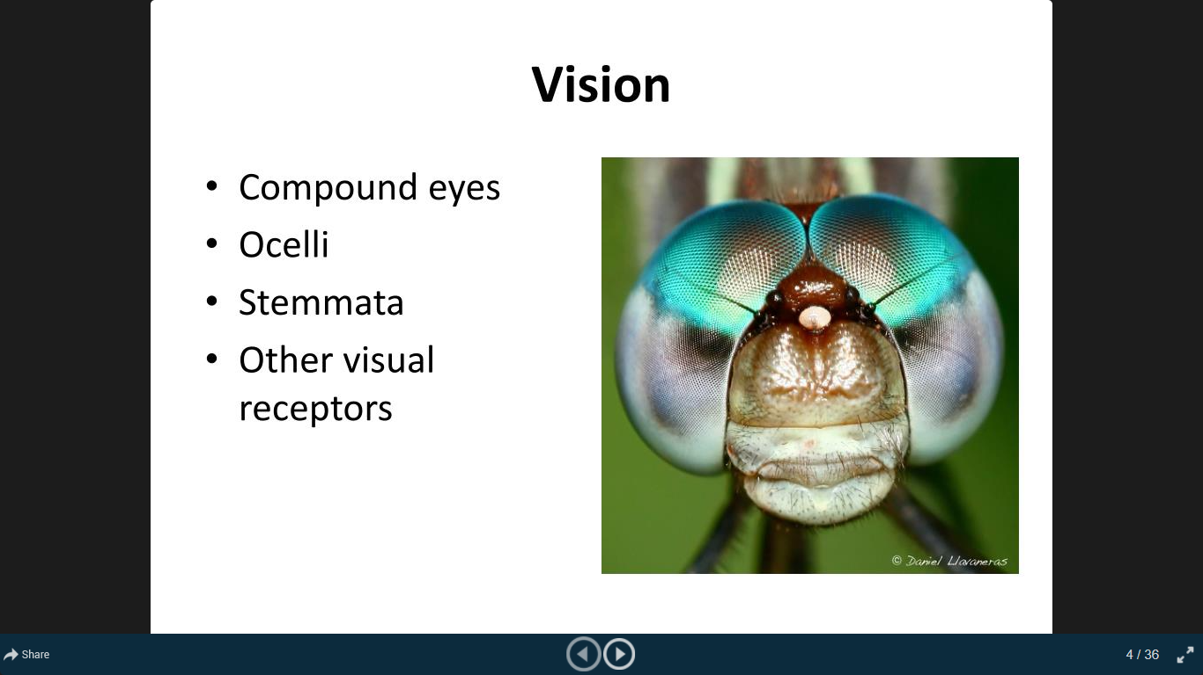
Vision in Arthropoda

Slide 2
Arthropods possess simple as well as compound eyes; the latter evolved in Arthropods and are found in no other group of animals.
Insects that possess both types of eyes are considered to be the most successful animals on earth.
Insects possess one pair of compound eyes and 1-3 simple eyes or ocelli on top of the head.
True eyes are found in almost all insects, except few parasitic forms and are of two types-simple and compound.
Simple eyes are dorsal ocelli and lateral stemmata.
Compound eyes are the principal visual organs of adult of many insects.
By possessing both types of eyes, insects enjoy both types of visions, namely detection of movement with compound eyes and distant vision with simple eyes or ocelli.

Slide 3
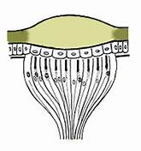
Dorsal Ocelli:
Insects bear three ocelli-one median and two lateral.
Basic difference between ocellus and compound eye are:
Ocellus bears dome shaped common lens for all visual cells.
Lens is cuticular
Retina is made up of only 4 retinula cells.
Axons form ocellar nerve.
Cone and pigment cells are absent.
Ocelli are incapable of forming image.
Ocellus bears a single lens and is cuticular in origin.
Ocelli are simple light sensitive or stimulatory organs activating central nervous system and thus play a key role in maintaining diurnal rhythm.
They are well adapted for quick perception of light and changing in its intensity.

Slide 4
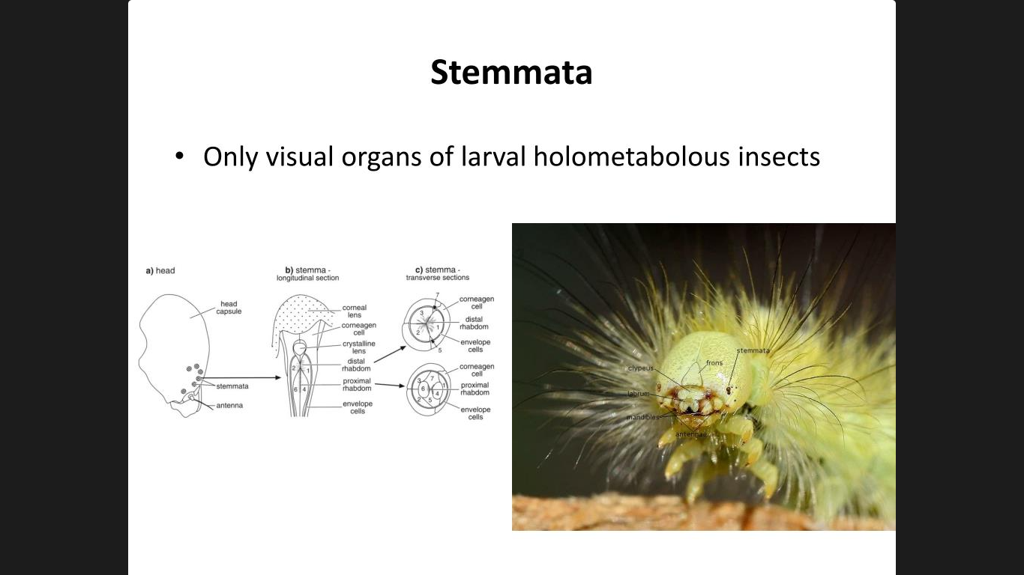
2. Stemmata:
Each stemmata is formed from a small group of photo-receptive structures resembling the ommatidia of a compound eye.
Each photo-receptive structural unit of stemmata (ommatidium) consists of:
External endocuticular cornea
Crystalline lens
Group of seven retinal cells
Some corneagen cells
Retinal cells differentiate retina into two parts:
Distal retina composed of three cells forming distal rhabdom.
Proximal retina composed of four cells forming proximal rhabdom.
Stemmata can form images on the rhabdom.
Images are formed on proximal rhabdom when the object is closer and are formed on distal rhabdom when object is at long distance.
They can differentiate the shapes and colours of object.

Slide 5
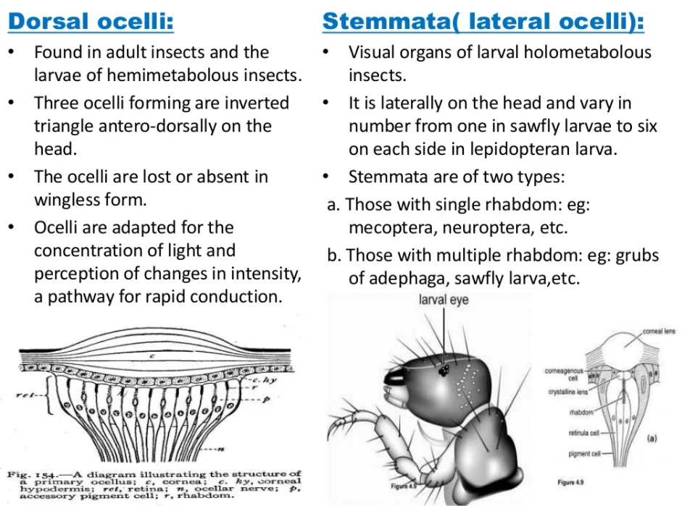

Slide 6
3. Compound eyes:
The compound eyes are the chief visual organs of Machilidae and majority of the pterygotes.
Compound eyes are composed of large no. off alike structural units called ommatidia.
Compound eyes differ from ocelli or stemmata in division of cornea into a large no. of facets.
The facets are arranged in hexagonal form.
Generally, all facets form a single spherical eye bulging out on parietal regions of head.
Facets size is mostly proportional to square root of height of eye.
Size of the facets situated at centre may differ from those situated dorsally or ventrally.

Slide 7
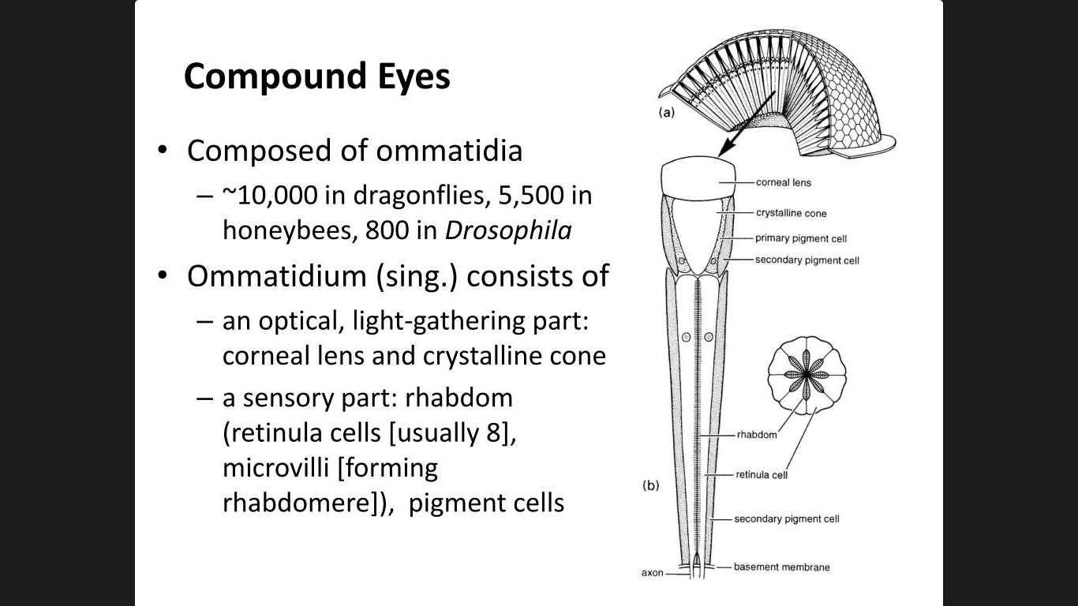
Structure of Ommatidium
Ommatidium consists of cornea, corneagen layer, cone or Semper’s cells, primary and secondary iris cells and retinula cells.
Cornea
It is the outermost part of ommatidium.
It is transparent, colourless and biconvex modified cuticular area, often termed as facet or lens.
It is cast off at each ecdysis and resecreted by epidermal corneagen cells.
b. Corneagen cells
These are epidermal or hypodermal cells lying behind the cornea.
A group of two corneagen cells secrete a single lens.
c. Cone or Semper cells
Beneath the corneagen layer or cornea, there are four distinct cells.
They secrete crystalline or liquid cone.

Slide 8
d. Retinula cells
Crystalline cone is followed by a long retina forming basal part of an ommatidium.
It is formed from a group of alike seven retinula cells as pigmented visual cells.
Each retinula cell posteriorly terminates above basement membrane and gives out post-retinal axonal fibre running towards optic lobe.
Rhabdom is an internal optic rod having a fibrillar structure and it becomes a central axis of retina.
e. Pigment or Iris cells
There are two groups of Iris cells:
Primary (around crystalline cone cells)
Secondary (around retinula cells)
Iris cells are provided with two types of pigment granules:
Black which absorb light.
Pale or other coloured granules that reflect light.
f. Tapetum
The fine branches of trachea invest basement membrane forming a tapetum.
It reflects back the light and as a result the rays retraverse the rhabdom.
g. Optic nerve fibres
Optic lobe of each side of brain is directly connected to compound eye.
Nerve fibres arising from retinula cells run parallel and are of 2 types:
Short fibres running to lamina.
Long fibres to medulla.

Slide 9
Types of ommatidia
On the basis of modifications of cone, ommatidia are recognised into 4 types:
Eucone ommatidia:
They contain true crystalline cone as a hard, refractive body formed from secretion of cone cells or Semper cells.
For example: Orthoptera, Odonata etc.
Psedocone ommatidia:
They do not contain true crystalline cone.
All cone cells are filled with gelatinous semi-liquid substance.
For example: Dermaptera, Hemiptera etc.
Acone ommatidia:
They do not contain either a crystalline or liquid cone but cone cells are elongated and transparent.
For example: Dermaptera, Hemiptera.
Exocone ommatidia:
They have an extra-cellular cuticular cone in the place of crystalline or liquid cone secreted by cone cells.
It is refractive in nature.
For example: Lampyridae
On the basis of rhabdom, eyes can be classified into 2 types:
Apposition eyes:
They contain rhabdom which is very long and extending from lens to basement membrane.
For example: cockroach
Superposition eyes:
These bear a comparatively short rhabdom.
For example: Coleoptera

Slide 10
THE MOSAIC VISION
The compound eye is incapable of giving distant vision and sharp vision but is efficient in picking up motion and in providing 360° view, as it is large globular and mounted on a movable stalk. Each ommatidium is capable of producing an independent image of a small part of the object seen and not the entire object. All these small images are combined in the brain to form a complete image of the object that is made of small dots or mosaic of dots and hence it is called mosaic vision. The range of the compound eye is not more than a foot and hence no single ommatidium can perceive the entire object. Movement of the objects can be detected much more efficiently by the compound eye because as the object passes in front of the eye, the ommatidia switch on and off according to their location in relation to the object. This characteristic of the compound eye helps the animal in detecting the movement of the predators and escape before the latter can strike.

