Slide 1
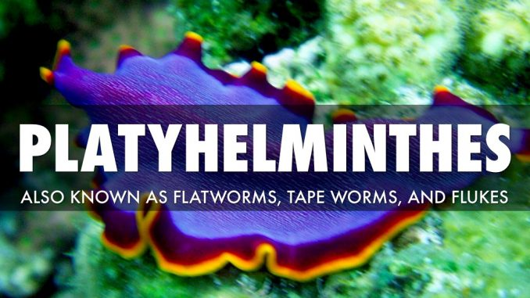
Dr. R. Prasad
Dept. of Zoology
Eastern Karbi Anglong College
Sarihajan, Karbi Anglong

Slide 2
Phylum Platyhelminthes (flatworms) characteristics
Phylum platyhelminthes belongs to the kingdom Animalia. Some forms are free living but many are parasitic.
Organ system level of organisation begin from this phylum.
They are bilaterally symmetrical and dorso-ventrally flattened, triploblastic worm.
- Bilaterally symmetrical with the definite polarity of head and tail ends.
-Triploblastic i.e. body derived from three embryonic germ layers; ectoderm, mesoderm, and endoderm.
-Dorso-ventrally fattened i.e. well-developed ventral surface with mouth and gonopore.
Their body is unsegmented except in class Cestoda.
Their anterior end of the body is differentiated into the head.
Mouth and genital pores on the ventral surface are well marked in turbellarians but less marked in cestodes and trematodes.
Their parasitic form has adhesive structures like hooks, spines and suckers, and adhesive secretions.
R. Prasad, EKAC

Slide 3
They are acoelomate i.e. without any body cavity.
Flatworms lack a respiratory or circulatory system; these functions take place by absorption through the body wall.
Excretion and osmoregulation by flatworms is controlled by "flame cells" located in protonephridia (these are absent in some forms).
Their digestive system is branched and incomplete without an anus and totally absent in acoela and cestode.
They are mostly monoecious (hermaphrodite) i.e. both male and female organs are present in the same body.
They reproduce sexually by fusion of gametes and asexually by fission and regeneration.
Fertilization is internal but cross-fertilization in trematodes and self-fertilization in cestodes.
Development may be direct (eggs hatch into tiny worms that resemble the adults) or indirect (with a ciliated larval form).
Their life cycle is complicated involves one or more hosts and various larval stages.
Movement in some flatworms is controlled by longitudinal, circular, and oblique layers of muscle.
R. Prasad, EKAC

Slide 4
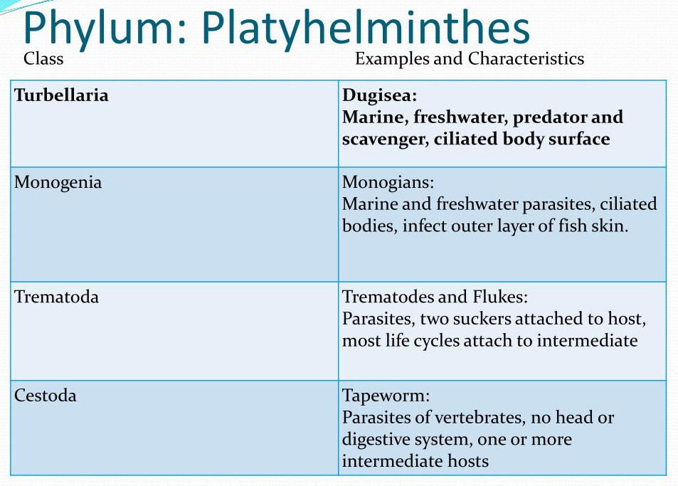
Classification
R. Prasad, EKAC

Slide 5
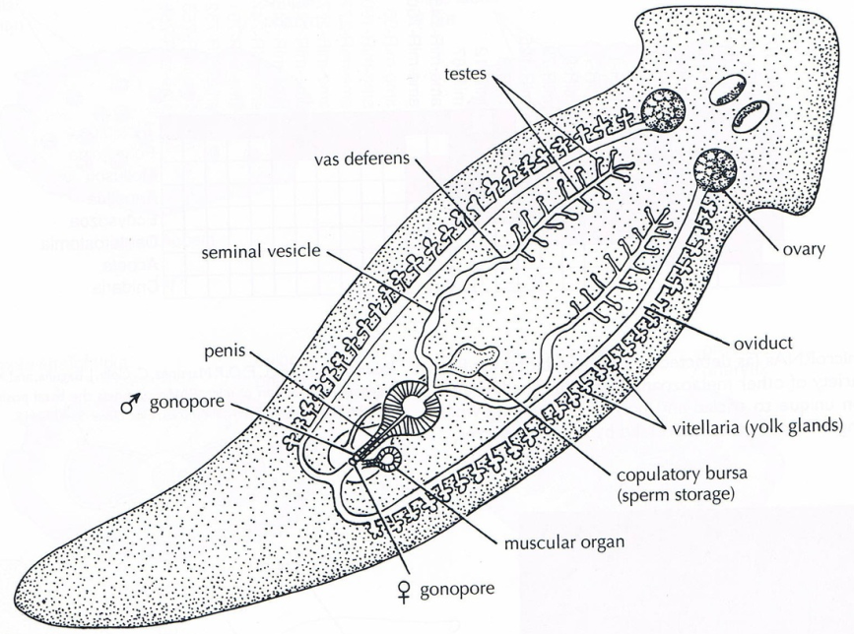
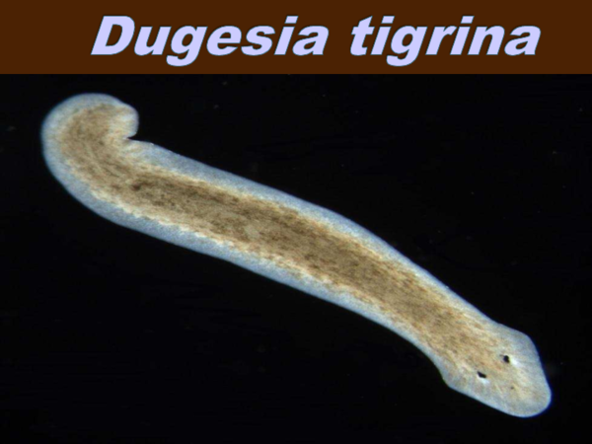
Class 1- Turbellaria (L., turbella= a little string)
Mostly free-living but some ectocommensals and endocommensals or parasitic. They are found in terrestrial, marine or freshwater.
Body unsegmented and covered with ciliated cellular or syncytial epidermis, containing mucus-secreting cells and rod-shaped body.
Mouth ventral and adhesive organs (suckers) abundantly present.
Sense organ i.e. chemo, and photoreceptors common in free-living forms.
The excretory system consists of protonephridia, the flame cells.
Mostly reproduction sexual, asexual by regeneration.
Life cycle is simple. Example: Dugesia (Planaria)
R. Prasad, EKAC

Slide 6
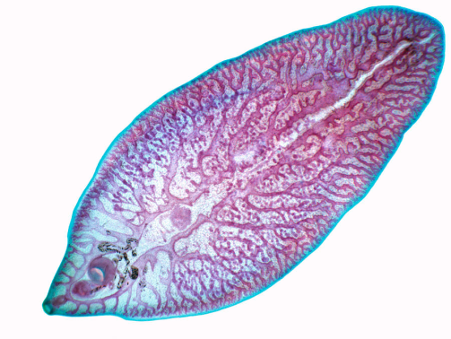
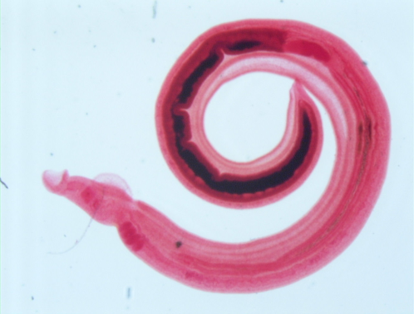
Class 2- Trematoda (Gr., trematodes= having pore)
They are ectoparasitic or endoparasitic.
Body unsegmented dorsoventrally flattened leaf-like.
Teguments thick but without cilia and body undivided and covered with cuticle.
Suckers and sometimes hooks present.
Digestive tract incomplete consists of the anterior mouth, simple pharynx and two forked or many branches intestine; anus absent.
3 pairs of the longitudinal nerve cord. Protonephridial excretory system consisting of flame cells.
Mostly hermaphrodites (monoecious).
Development direct (in ectoparasites) or indirect (in endoparasites) with alternation of hosts. Example: Fasciola hepatica (liver flukes), Schistosoma (blood fluke).
R. Prasad, EKAC

Slide 7
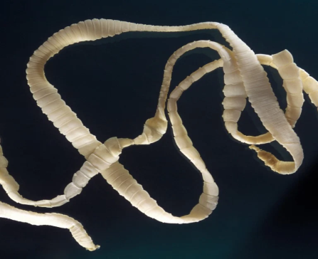
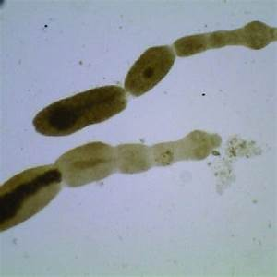
Class 3- Cestoda (Gr., ketos, gridle+ eidos, form)
Commonly called tapeworms and endoparasitic in the intestine of vertebrates.
Body divided into many segmented (proglottids) but rarely undivided, elongated, flat, ribbon-like.
Body without epidermis and cilia but covered with cuticle.
Anterior end (scolex) is provided with adhesive structures (hooks, suckers).
Mouth and digestive systems totally absent.
The excretory system consists of protonephridia with typical terminal flame.
The nervous system usually comprises a pair of ganglia and 2 lateral longitudinal nerve cords.
Each mature segment or proglottids are monoecious, with male and female organs.
Life cycle complicated usually involving 2 or more hosts.
Example: Taenia solium (pork tapeworm), Taenia saginata (beef tapeworm), Echinococcus (dog tapeworm).
R. Prasad, EKAC

Slide 8
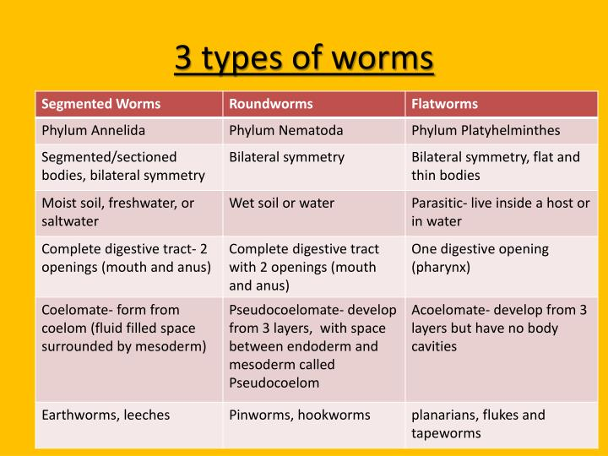
R. Prasad, EKAC

