Slide 1
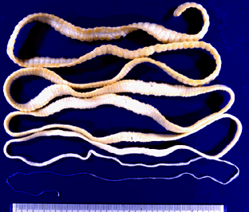
LIFE HISTORY
OF
TAENIA SOLIUM
Dr. R. Prasad
Dept. of Zoology
Eastern Karbi Anglong College
Sarihajan, Karbi Anglong

Slide 2
Introduction
Taenia solium, the pork tapeworm, belongs to the cyclophyllid cestode family Taeniidae. It is found throughout the world and is most common in countries where pork is eaten.
It is the endoparasite and adult worm lives in small intestine of man who eat pork.
It is a tapeworm which has humans as its definitive host and often pigs as intermediate or secondary host.
It may be transmitted to pigs through human faeces contaminating their fodder, and back to humans through consumption of uncooked, or under-cooked, pork that contains tapeworm cysts.
Pigs ingest tapeworm eggs, which develop into larvae, then into oncospheres, and ultimately into infective tapeworm cysts. An ingested tapeworm cyst grows into an adult worm in human small intestines.
There are two forms of human infection. One is "primary hosting", and is due to eating under-cooked pork that contains the cysts and results in adult worms in the intestines.
The other form, "secondary hosting", is due to eating food, or drinking water, contaminated with faeces from someone infected by the adult worms, thus ingesting the tapeworm eggs, instead of the cysts.
R. Prasad, EKAC

Slide 3
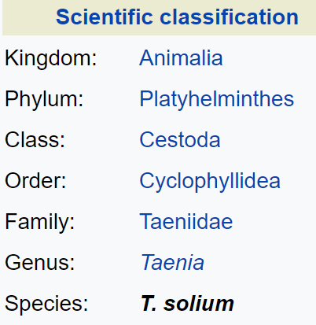
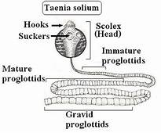
The adult worm has a flat, ribbon-like body which is white in colour and measures 2 to 3 metres long, or more.
Its tiny attachment, the scolex, contains suckers and a rostellum as organs of attachment that attach to the wall of the small intestine.
The main body, consists of a chain of segments known as proglottids. Each proglottid is a little more than a self-sustainable, very lightly ingestive, self-contained reproductive unit since tapeworms are hermaphrodites.
R. Prasad, EKAC

Slide 4
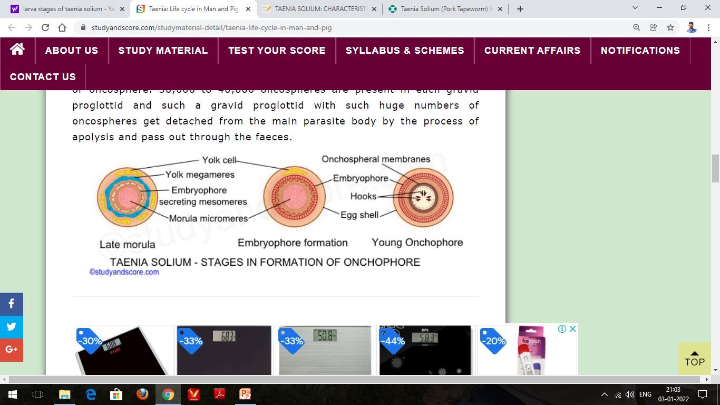
Taenia solium is a flat-ribbon like tape worms that causes intestinal taeniasis.
Adult worms are rarely pathogenic but the encysted larval stage (cysticercus cellulosae) of the worm caused a serious disease in human called Cysticercosis.
The adult worm inhabits the small intestine (upper jejunum) of human.
The life cycle of Taenia solium is complicated and completed in two hosts (i.e., digenetic).
Definitive host: Human
Intermediate Hosts: Pig, occasionally human.
Hexacanth/oncosphere larva
The micromeres develop into a hexacanth or oncosphere. The oncoblasts of the embryo secretes three pairs of chitinous hooks. This embryo with six hooks surrounded by two embryonic membranes is called as hexacanth larva or oncosphere. 30,000 to 40,000 oncospheres are present in each gravid proglottid and such a gravid proglottid with such huge numbers of oncospheres get detached from the main parasite body by the process of apolysis and pass out through the faeces.
R. Prasad, EKAC

Slide 5
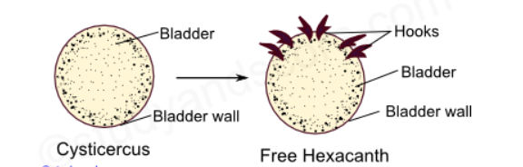
Infection to secondary host takes place through the oncosphere stage. The gravid proglottid containing oncospheres are present in the infected human faeces. When a pig feeds on such faecal matter, the gravid proglottids enter the stomach of the pig and get released.
Cysticercus larva
The hexacanth loses its hooks in the voluntary muscles of the pig and develops into a pre-adult stage called as cysticercus or metacestode phase. The early cysticercus absorbs nutritive substance from host tissues and grows in size. A cavity appears in the center of its cell mass due to the degeneration of the mesenchymal cells. This cavity gets filled with fluid containing plasma of the pig. At this stage the embryo is surrounded by two layers namely the outer cuticle and the inner mesenchymal layer or germinal layer.
R. Prasad, EKAC

Slide 6
The wall of the embryo gets thickened and invaginates into tits cavity in the form of a knob. Internally this knob develops four suckers, a small rostellum and hooks at its base. It is called as proscolex. The embryo is now called mature cysticercus or hydatid larva or bladder worm. It has ellipsoid milky white bladder surrounded by fibrous capsule. These cysts are called cysticercus cellulosae. The pork with these cysticercus cellulosae is called measly pork.
Infection to the final host
Further development of the bladder worm takes place only inside the definitive host. Infection of man occurs when inadequately cooked pork infected with bladder worms is eaten. The cysticercus becomes active in the intestine. The scolex takes a firm hold of intestinal wall of the host. The bladder is thrown off and the neck starts budding off segments an adult tapeworm is formed.
R. Prasad, EKAC

Slide 7
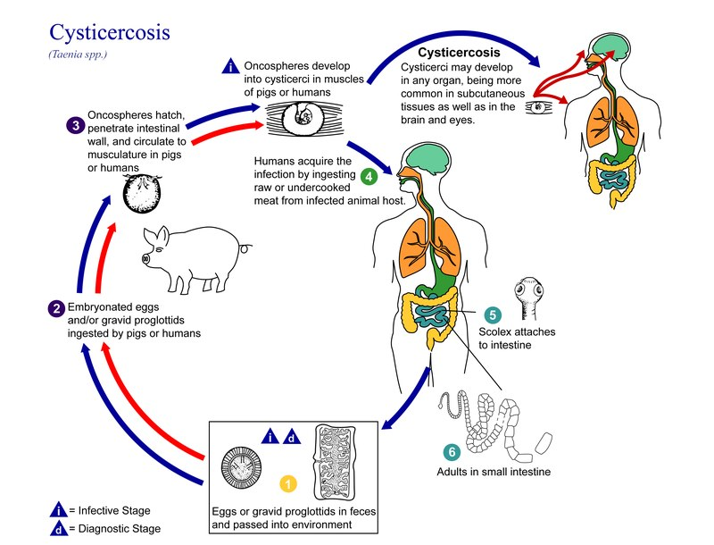
Life cycle of T. solium
R. Prasad, EKAC

Slide 8
The life cycle of T. solium consists of six main steps:
STEP 1: Infected humans (definitive host) excrete the eggs or gravid proglottids in their feces, passing the parasite from the gastrointestinal tract onto nearby vegetation. In egg or gravid proglottid form, T. solium is able to remain viable anywhere from days to months. T. solium can be diagnosed at this point in the life cycle.
STEP 2: Pigs (intermediate host) acquire infection by eating and digesting the eggs or gravid proglottids along with the parasitized vegetation.
STEP 3: The eggs or gravid proglottids migrate to the pig's intestine and as oncospheres, break through the intestinal wall. Then, via the circulatory system, they embed themselves in the muscles of the pig and develop into cysticerci (the infective form of T. solium). Cysticerci have the ability to persist in the muscle for many years.
STEP 4: Humans acquire the infection by eating the undercooked or raw flesh of an infected animal.
STEP 5: Cysticerci migrate to the small intestine of the human host and develop into their adult tapeworm form normally within two months.
STEP 6: By attaching to the intestinal wall with their scolices (hooked structures), these adult tapeworms may persist for long periods of time, even years.
R. Prasad, EKAC

Slide 9
Pathogenicity
Taenia solium is responsible for two diseases: taeniasis, which is caused by the adult parasite, and cysticercosis, which is caused by cysts that form in various body tissues, such as the brain, muscles, and lungs.
Taeniasis
It is a parasitic infection that can be caused by several species of the genus Taenia: T. saginata, T. asiatic and T. solium. People with this disease harbor adult specimens of Taenia solium in the intestine. These are fixed to the intestinal walls through the hooks of the scolex and the parasite absorbs the nutrients that the individual ingests.
Symptoms of intestinal infection by Taenia solium are as follows:
Loss of appetite
Sickness
Frequent liquid stools
Weight loss caused by decreased absorption of nutrients.
Strong desire to consume salt
Weakness
Dizziness
R. Prasad, EKAC

Slide 10
There are several diagnostic tests to establish whether an individual is infected by Taenia solium. Some of these involve:
Blood tests
Stool analysis
Collection of eggs
CT scan, ultrasound, MRI, and X-rays
Cysticercosis
Cysticercosis is an invasive infection caused by ingestion of eggs of Taenia solium. In the intestine, once they transform into the oncosphere, they invade the bloodstream and are transported to other organs of the body where they form cysts.
Symptoms
Symptoms depend on where the cysts have formed.
Cerebral cysticercosis
Severe headaches
Blurry vision
Seizure episodes
Alterations when walking
R. Prasad, EKAC

Slide 11
Ocular cysticercosis
Point vision
Photophobia
Blindness
Blurred or cloudy vision
Swelling of the retina that can lead to detachment
Cardiac cysticercosis
Abnormal heart rhythm
Heart failure
Musculocutaneous cysticercosis
Localized pain radiating to nearby organs.
Presence of lumps or lumps under the skin.
Diagnosis
To diagnose cysticercosis, several tests are necessary, in order to reach an accurate diagnosis. First, blood tests are performed which uses purified glycoprotein antigens from the cyst; it is very reliable. Parasite DNA detection tests can also be carried out using the polymerase chain reaction (PCR) technique. Other very useful diagnostic methods are those that use images. Among these, the one that is most specific is magnetic resonance imaging (MRI), since it shows images of lesions that do not even appear on computerized axial tomography (CT).
R. Prasad, EKAC

Slide 12
Prevention and treatment
The best way to avoid getting tapeworms is to not eat undercooked pork or vegetables contaminated with faeces. Moreover, a high level of sanitation and prevention of faecal contamination of pig feeds also plays a major role in prevention. Infection can be prevented with proper disposal of human faeces around pigs, cooking meat thoroughly or freezing the meat at −10 °C for 5 days.
Cysticercosis is usually asymptomatic unless larvae invade the central nervous system, resulting in neurocysticercosis, which can cause seizures and various other neurologic signs. Adult worms can be eradicated with praziquantel or niclosamide. Treatment of symptomatic neurocysticercosis is complicated; it includes corticosteroids, antiseizure drugs, and, in some situations, albendazole or praziquantel. Surgery may be required.
R. Prasad, EKAC

Slide 13
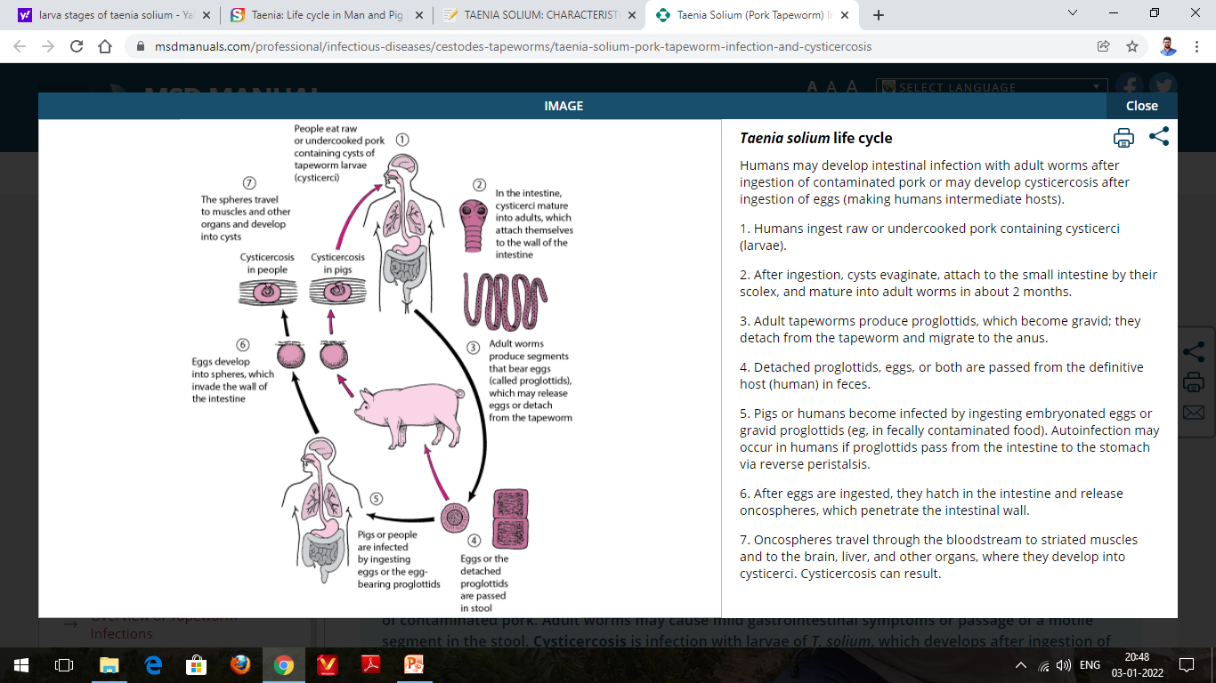
R. Prasad, EKAC

